Slide 1

Shoppers Style
AI-Powered E-commerce Website
Project Supervisor:
Apoorv Jain
Assistant Professor
Saurav Kumar Sinha (2300290140165)

Slide 2
Abstract
Shoppers Style is an AI-powered e-commerce website designed to elevate the online shopping experience through advanced technology.
Key features include AI-driven personalized product suggestions, smart product descriptions, and intuitive image-based search capabilities.

Slide 3

Introduction
Shoppers Style is an e-commerce platform integrating AI to improve shopping experiences. Provides seamless browsing, secure transactions, and personalized recommendations.

Slide 4
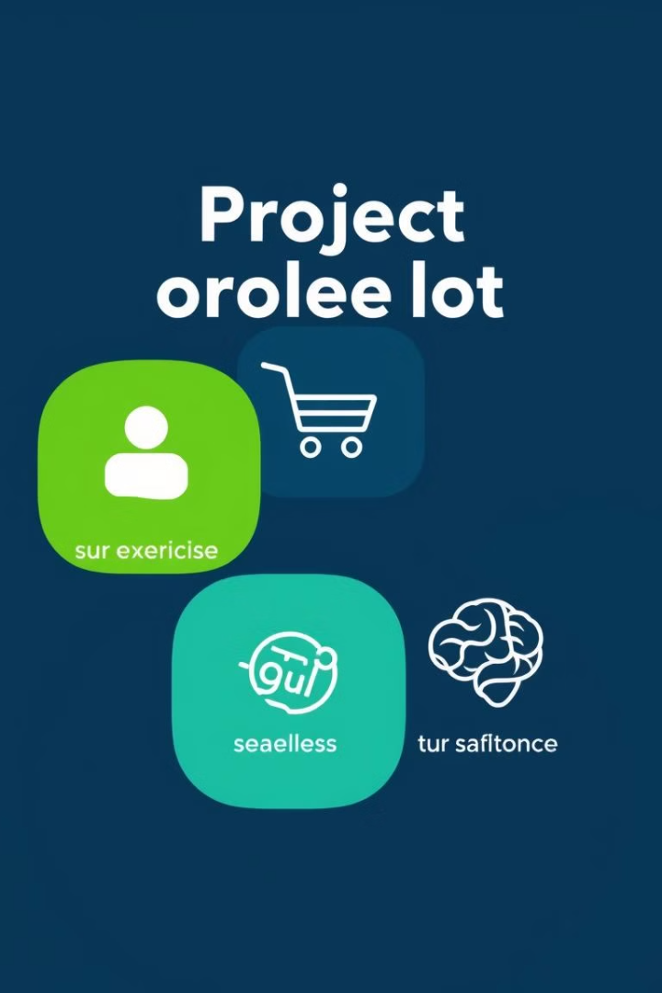
Project Objectives
1
Develop an AI-powered e-commerce platform
2
Implement product recommendations and image-based search
3
Use AI for dynamic pricing and product descriptions
4
Improve customer engagement and satisfaction with a 24/7 AI chatbot.
5
Ensure a secure and user-friendly experience

Slide 5
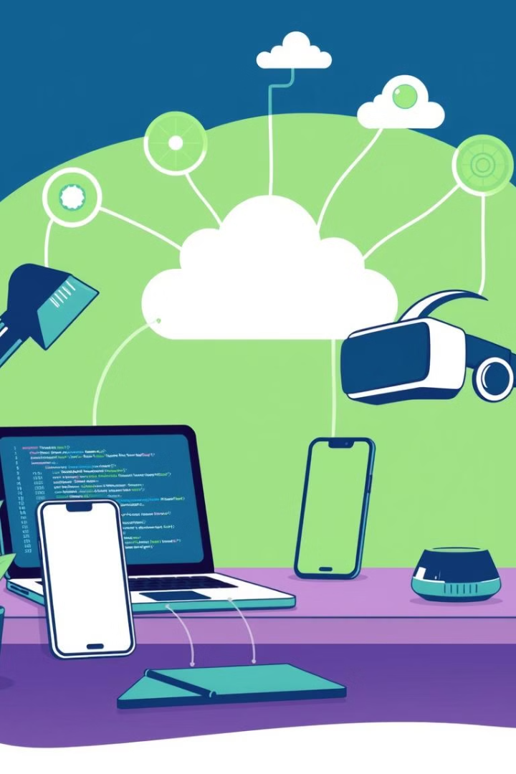
Technologies Used
MERN Stack
AI Algorithms
MongoDB, Express.js, React.js, and Node.js
AI, Machine learning, OpenAI

Slide 6
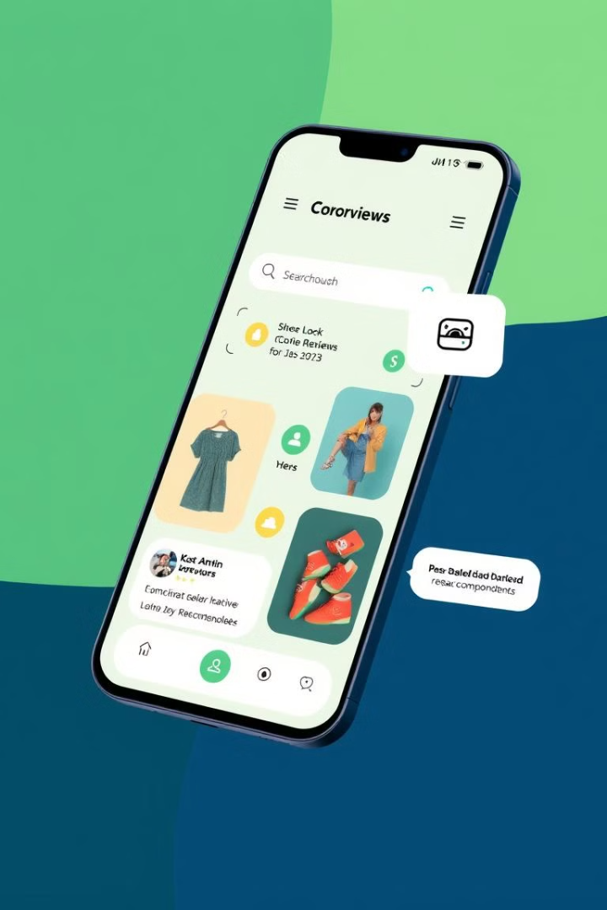





Features
User login and account management
Shopping cart and secure checkout
AI-powered chatbot for customer support
Image-based search using visual recognition
Dynamic Pricing based on demand
Secure Payment Integration

Slide 7
Methodology
Frontend built with React.js for a dynamic UI
1
2
Backend using Node.js & Express.js for handling requests
MongoDB for storing products, users, and orders
3
4
AI services integrated for personalization and automation
Testing and quality assurance
5
6
Deployment and ongoing maintenance

Slide 8
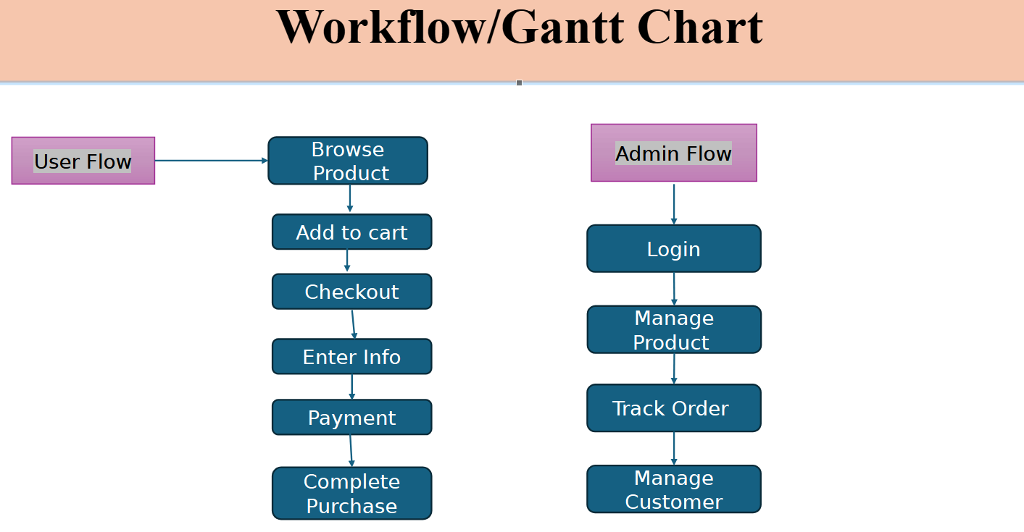

Slide 9
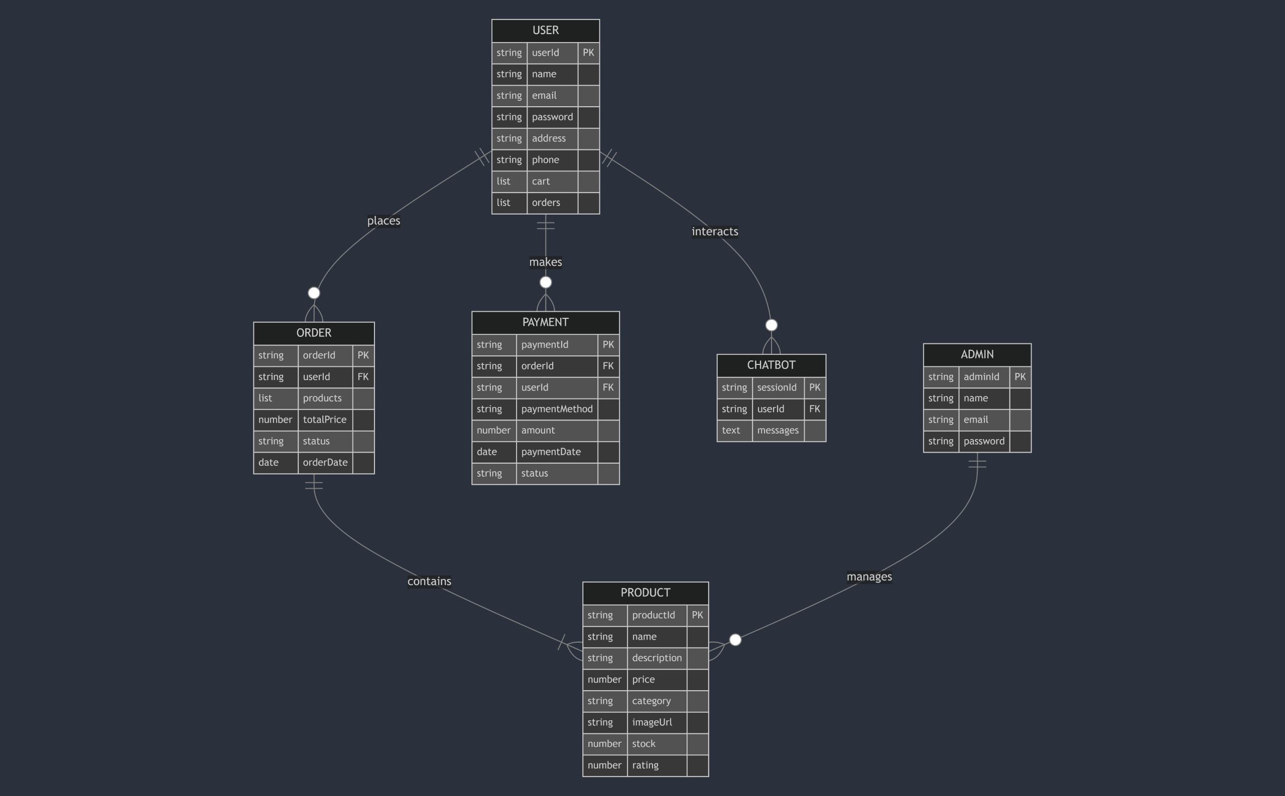
Entity Relationship Diagram

Slide 10
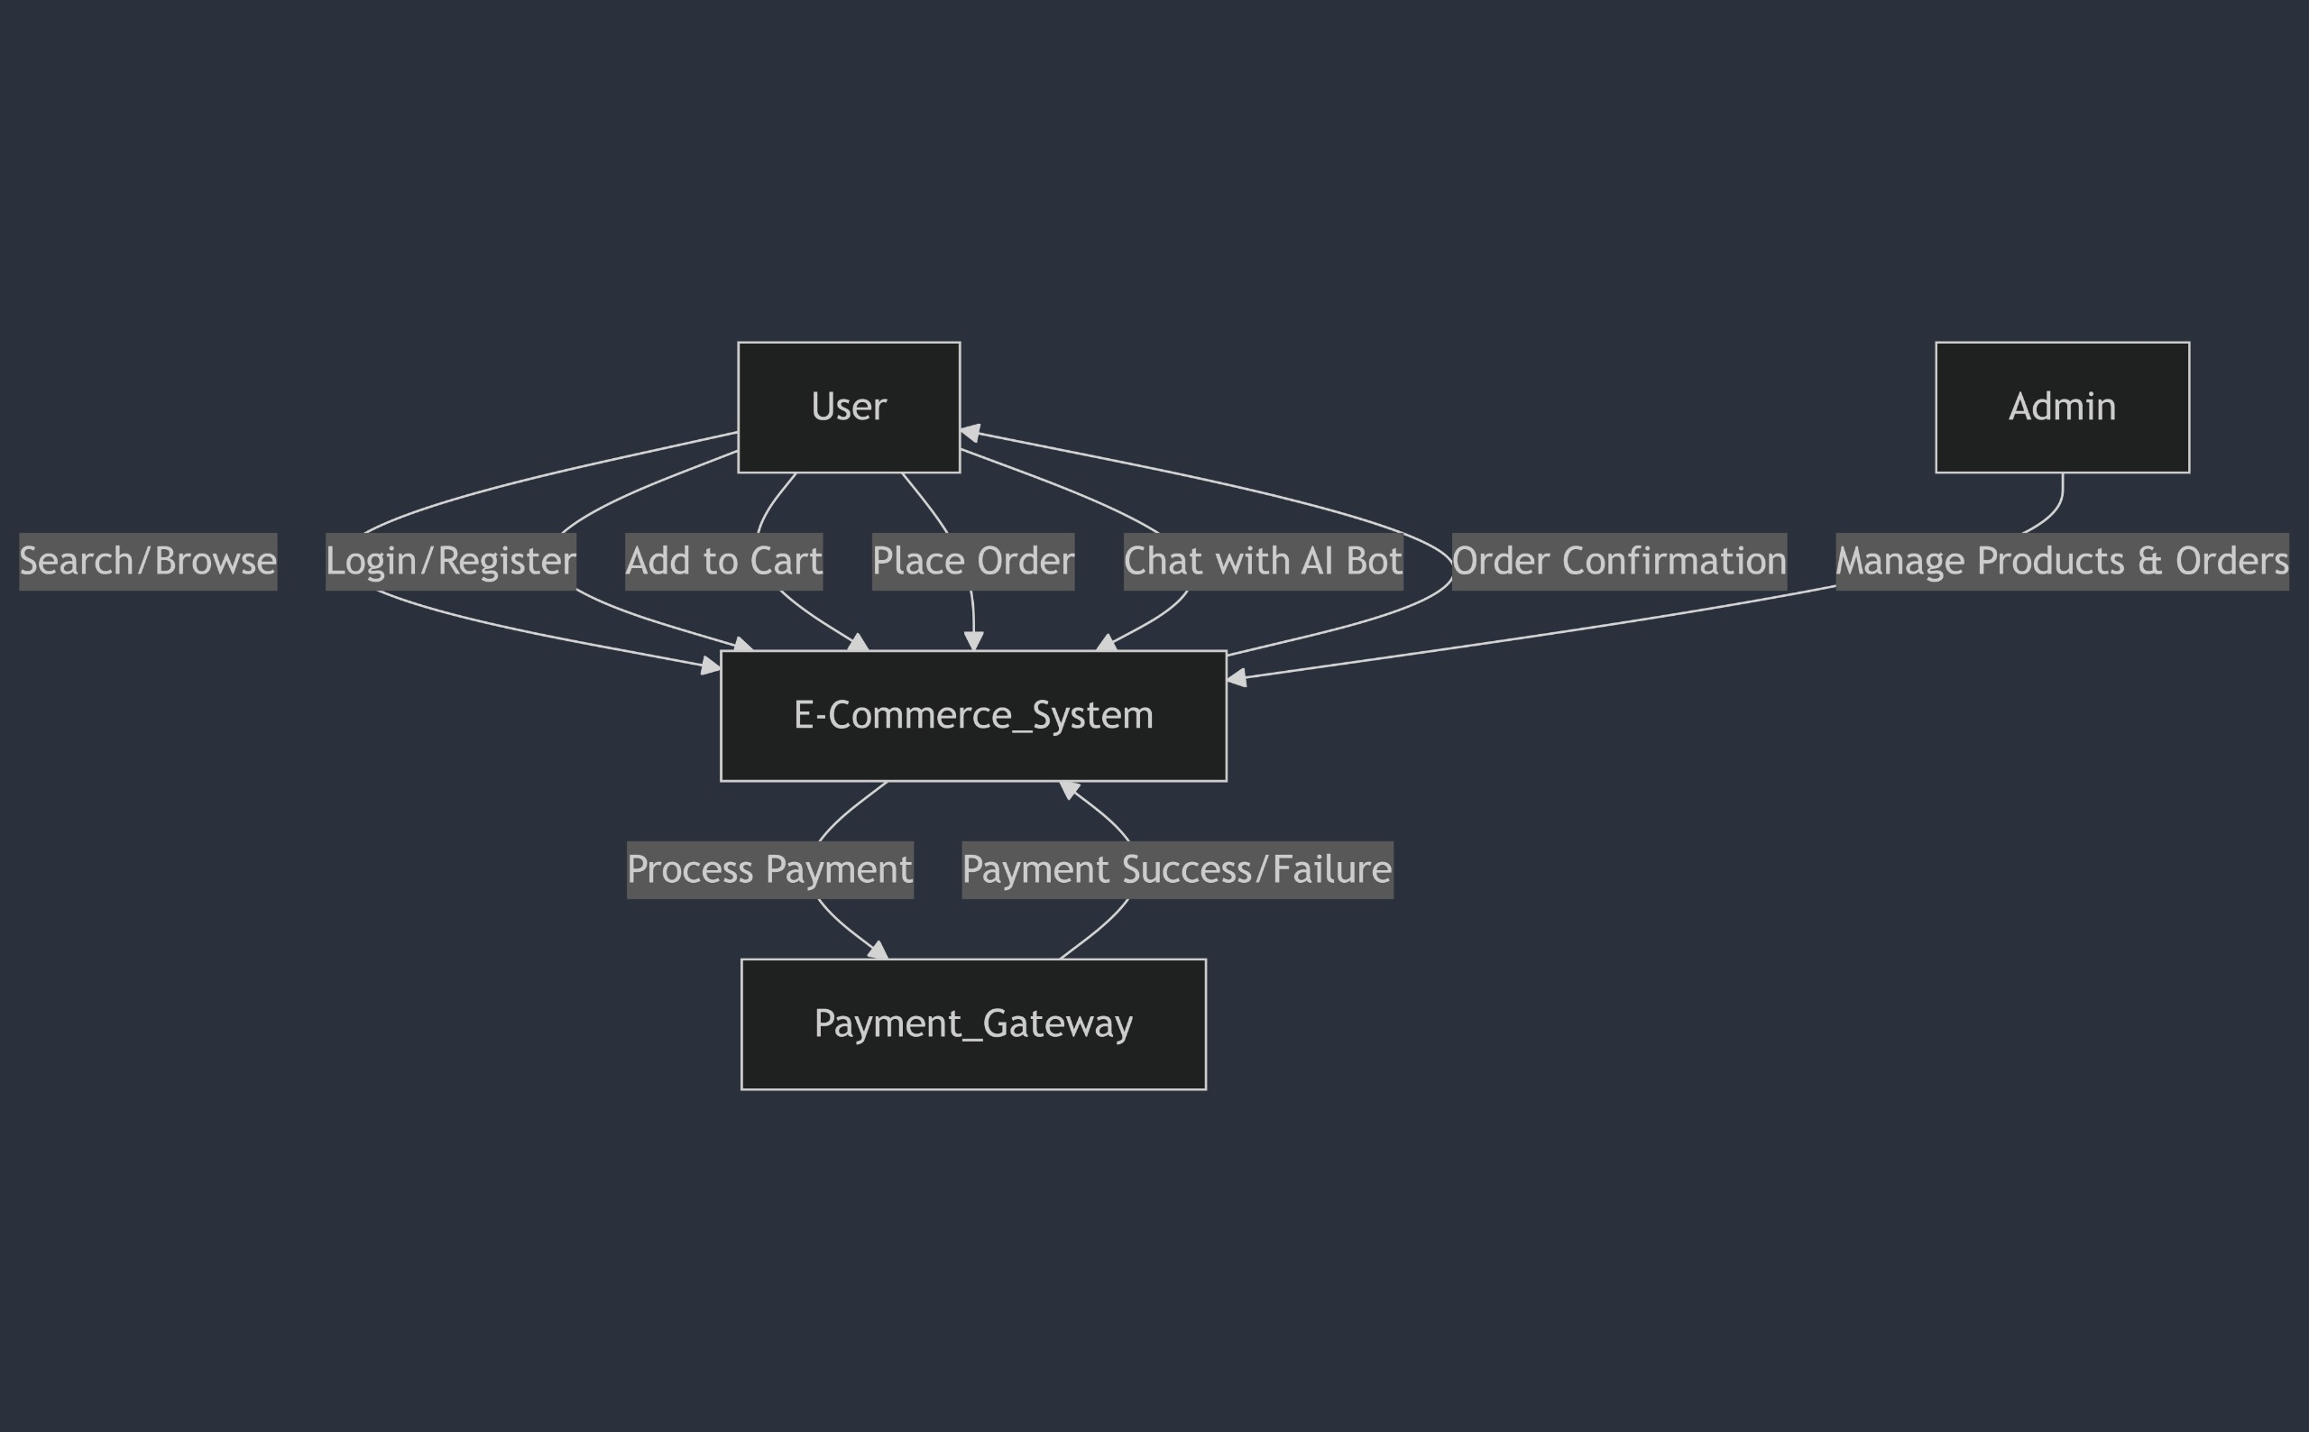
Data flow diagram

Slide 11





Expected Outcomes
A user-friendly e-commerce website with AI-driven personalization
Improved shopping experience with smart recommendations
Efficient product search using image-based queries
Dynamic pricing adapting to market trends

Slide 12

Conclusion
Shoppers Style demonstrates how AI enhances online shopping by making it more personalized and efficient.
By integrating AI with the MERN stack, the project provides an innovative and scalable e-commerce solution.

Slide 13

References
List of references for technologies, tools, and APIs used (MongoDB, Express.js, React.js, Node.js, Razorpay).
https://www.mongodb.com/resources/languages/express-mongodb-rest-api-tutorial
https://www.geeksforgeeks.org/razorpay-payment-integration-using-node-js/
https://react.dev/learn https://expressjs.com/en/5x/api.html
https://www.tutorialspoint.com

